Slide 1

Lesson 9 hands on
Comparing per capita and life expectancies

Slide 2
Comparison of 5 countries
Looking at the per capita for years 1952 & 2007,
both highest and lowest
Life expectancy from 1952-2007
Median life expectancy

Slide 3
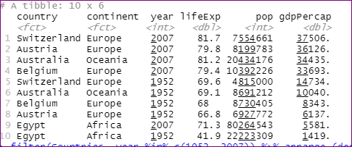
Highest per capita for 1952 & 2007
And the highest per capita for both 1952 and 2007 is Switzerland.
Switzerland is home to people of great wealth, it is a vacation spot for the wealthy, they have some of the best medical minds there, the Swiss guard protects the Pope and not to mention the best watches and chocolate in the world. So the income ratio of course is higher as they have higher income streams.

Slide 4
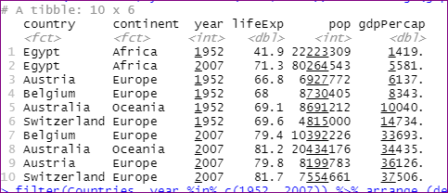
Lowest per capita: years of 1952 & 2007
The lowest per capita for both 1952 and 2007 were both for the country of Egypt. Maybe it took longer to recover from post –WWII, and the large amount of fighting in the middle east

Slide 5
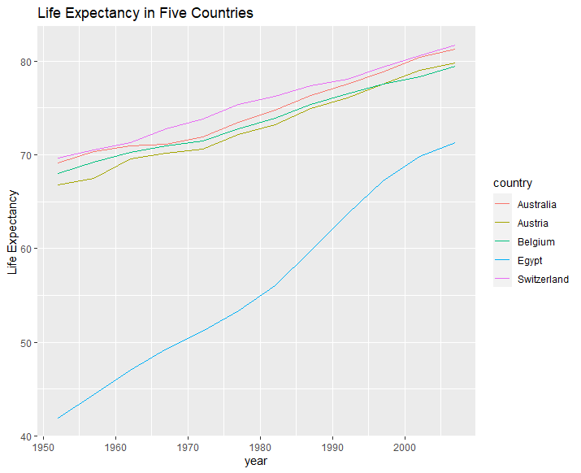
Life expectancies of five countries
Again Egypt is at the low end for life expectancy; the increase took almost three decades to reach where Australia, Austria, Belgium and Switzerland started.
With less percapita it is safe to say they are not able to have the means to stay healthy as the other countries with more income.
Australia, Austria, Belgium and Switzerland are home to people of higher incomes so with better health care and quality of living the life expectancy is higher than Egypt, which is still in most parts still rather poor.

Slide 6
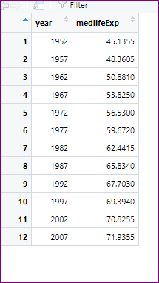
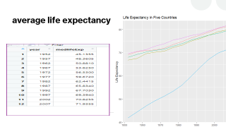
average life expectancy

Slide 7
The law of averages
In 1952 the average life expectancy was 45 years old.
55 years later in 2007 the average life expectancy was 72
In 1952 the countries of Australia, Austria, Belgium, & Switzerland were at an average expectancy between 68-70.
How do the five countries compare to the rest of the countries as far as the average life expectancy?

Slide 8
And now a word from our sponsors
#see the countries: levels(gapminder$country)
#find all the years in the dataset
unique(gapminder$year)
#which country of the five has the lowest per capita GDP in 1952?
Egypt
2007? Egypt
Countries <- gapminder %>% filter (country %in% c("Belgium", "Austria", "Egypt","Australia", "Switzerland"))
View(Countries)
filter(Countries, year %in% c(1952, 2007)) %>% arrange(gdpPercap)
#which has the highest per capita GDP in 1952? 2007?
filter(Countries, year %in% c(1952, 2007)) %>% arrange (desc(gdpPercap, year))
#create a line plot with year on the horizontal axis(x) and lifeExp on the vertical axis(y) for the five countries; give each country a different color line.
ggplot(Countries) + geom_line(aes(x = year, y = lifeExp, color = country)) +
ylab("Life Expectancy") + ggtitle("Life Expectancy in Five Countries")
#on the entire gapminder data frame compute the median of lifeExp for each year. for what years is the life expectancy of your five countries above the median life expectancy for the entire gapminder data frame?
median <- gapminder %>% select (year, lifeExp, country ) %>% group_by(year,) %>% summarise(medlifeExp= median(lifeExp))
View(median)
The above information is a direct result of the listed codes, with help from:
library(ggplot2)
library(dplyr)
library(gapminder)
dataset(gapminder)

